Slide 1

Introduction to Java Programming
Brian Craig

Slide 2
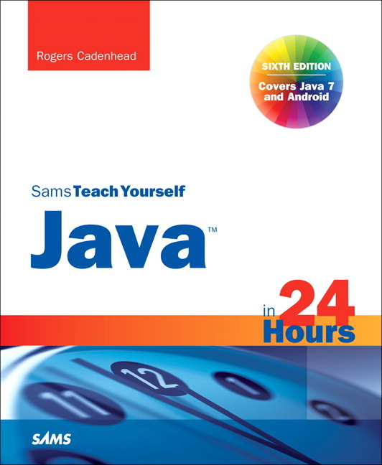
Text
Sams Teach Yourself Java in 24 Hours
6th Edition
Rogers Cadenhead

Slide 3
Hour 1
Becoming a Programmer

Slide 4
Becoming a Programmer
Programming is not difficult
Great time to learn
Mobile

Slide 5
Choosing a Language
Languages
BASIC
Visual Basic
C#
C++
Java
100’s of others
Why Java?
Used on internet & mobile phones
Organized language
Invented by James Gosling
Didn’t like C++
3 billion devices run Java
Learning one language makes it easy to learn others

Slide 6
Telling the Computer What to Do
Computer Program = Software
Everything a computer does is done by software
Examples:
Windows 8, Minecraft, Internet Explorer, iTunes, viruses
Programs made up of list of commands to be performed in a specific order
Command = Statement
Example:
Clean your room
Mow the lawn
Play videogames
Go to bed

Slide 7
Telling the Computer What to Do
Go to: www.calormen.com/applesoft
Enter the following commands:
10 PRINT “Shall we play a game?”
20 INPUT A$

Slide 8
How Programs Work
Interpreted Languages
Compiled Languages

Slide 9
When Programs Don’t Work
Syntax Errors
Broke the rules of the language
Computer doesn’t understand
Compile-time error
Logic Errors
Obeys the rules of the language
Computer doesn’t do what you want or expect
Run-time error

Slide 10
Choosing a Java Programming Tool
Java Development Kit (JDK)
NetBeans Integrated Development Environment (IDE)

Slide 11
Installing a Java Development Tool
Use the provided CD
Install JDK on your PC
Try 64-bit version first
If it does not work, use x86 version
Install Netbeans on you PC

Slide 12
Summary
Concept of Programming – Giving instructions
Installed JDK and Netbeans

Slide 13
Questions

Slide 14
Workshop

Slide 15
Activities

Slide 16
Hour 2
Writing Your First Program

Slide 17
What You Need To Write Programs
Netbeans IDE
Source code (Text) editor
Simple text files – can open in Notepad
Color highlights

Slide 18
Creating a Project for This Class
We need to create a project for this class
All our programs will go into this project
Open Netbeans
Select File > New Project
Category: Java
Project: Java Application
Click Next
Project Name: Java24
Deselect “Create Main Class”
Click Finish

Slide 19
Beginning the “Hello World” Program
Our first program will simply print “Hello World” on the screen
Add a new program to the Java24 Project
File > New File
Project: Java24
Categories: Java
File Types: Empty Java File
Click Next
Name and Location
Name: HelloWorld
Package: <blank>
Note created file name (HelloWorld.java)
Click Finish

Slide 20
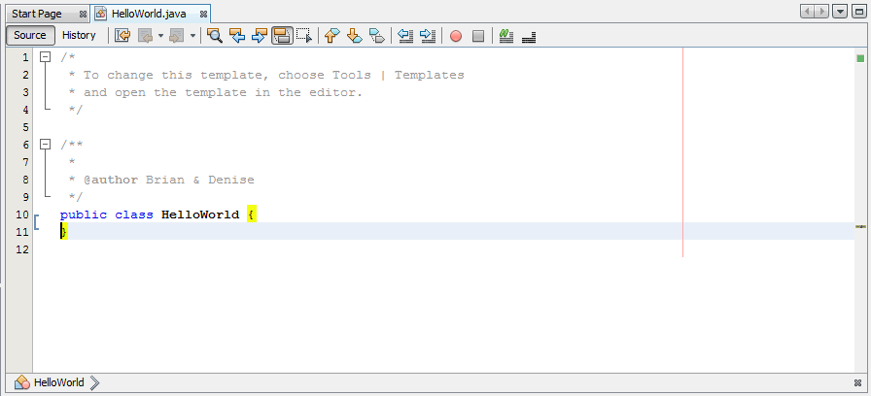
The class Statement
Gives your class (program) a name: HelloWorld
In Java class name always matches the file name

Slide 21
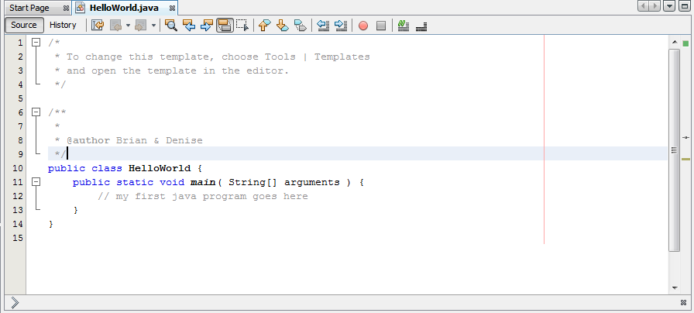
What the main Statement Does
The main part of the program begins here
Programs always start with main
Exceptions: applets and servlets
The main part of the program begins here
Programs always start with main

Slide 22
Those Squiggly Bracket Marks
The main part of the program begins here
Programs always start with main
Exceptions: applets and servlets
{ and } enclose blocks
Class Block
Main Function block
Blocks inside of blocks - Nesting

Slide 23
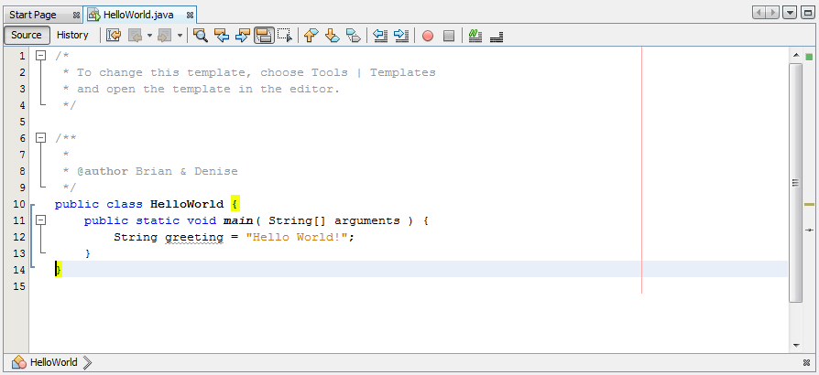
Storing Information in a Variable
Variable: storage place in computer memory:
Numbers, characters, text, true/false
Can change
Type of variable:
String
Content of variable:
Hello World
Statement ends with ;

Slide 24
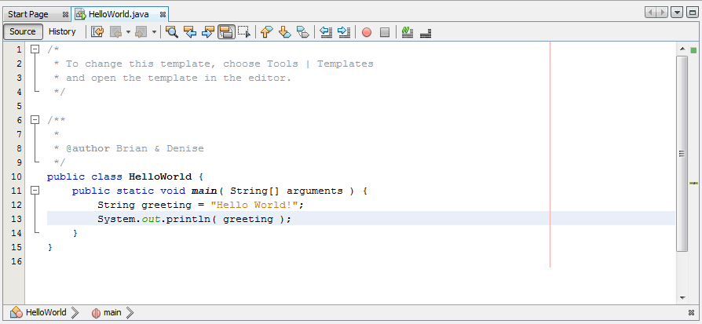
Displaying the Contents of a Variable
Print the greeting to the console
Save the file: File > Save

Slide 25
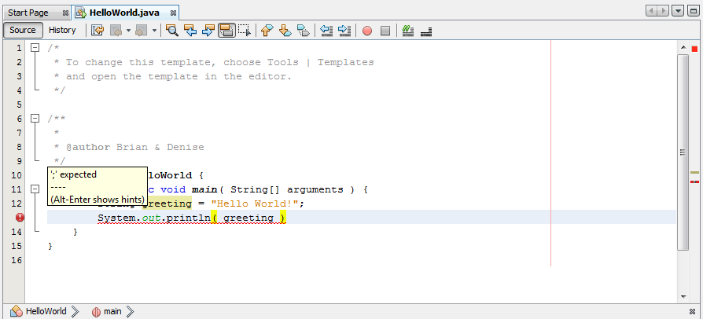
Fixing Errors
Error due to missing semicolon

Slide 26
Running a Java Program
Run > Run Project, or
Run button (green arrow), or
F6
Output displays in Output pane

Slide 27
Summary
Wrote our first program
Compile program
Run program

Slide 28
Questions

Slide 29
Homework
Read Chapter 3
Visit the websites mentioned in the text

